Slide 1
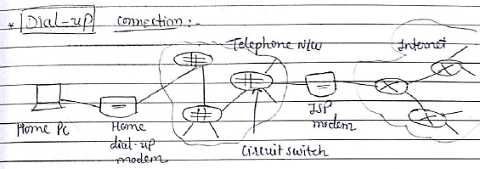
Dial up Connection

Slide 2
Modem
Modem= Modulator + demodulator
Modulator: It will convert digital signal to analog signal (because telephone line only understands analog signal and computer or PC understands only digital signal) for sending data.
Demodulator: It will convert analog signal to digital signal to transfer data at the receiver. (Opposite process of modulator)

Slide 3
In 1990s, Internet was accessed over analog telephone lines using dial up modem.
User’s software dials an ISP’s phone number and makes a phone connection with ISP.
End device is attached to dial up modem.
Modem is attached to telephone network line, home modem converts digital output of pc into an analog format for transmission over analog phone line.
At the end ISP modem converts analog signal into digital signal for input to ISP’s router.

Slide 4
Drawback of Dial up connection
It is extremely slow, Maximum speed provides only 56 kbps
It will connect with phone line so that only one task can be performed at a time either user can access internet or phone calls.
During accessing internet if phone call comes then internet will be disconnect.
User can only attempt phone call or use internet at a time.

Slide 5
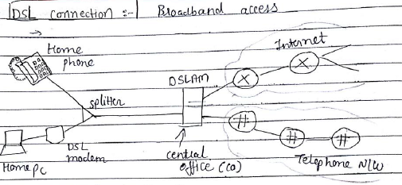
DSL connection or Broadband Access

Slide 6
DSL: Digital Sub Scriber Line
It uses existing telephone line (twisted pair) to exchange data with DSLAM (Digital Subscriber Line Access Multiplexer)
Telephone line carries both data and telephone signals with different frequencies
Due to frequency division telephone and internet can share connection at the same time.
User can use both internet and phone calls at a time.

Slide 7
Advantages of DSL Connection
Transmit and receive data at much higher rates
Phone calls and internet can be accessed simultaneously
“Always on” means permanent connection

Slide 8
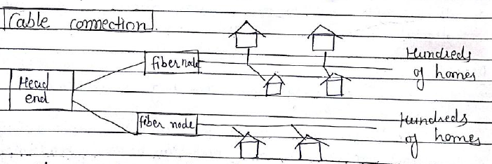
Cable Connection

Slide 9
It is obtained from the same company
Fiber optic cable is used between head end and neighborhood junction
From junction to home coaxial cable is used
Both cable is used so that it is known as hybrid fiber coax (HFC)
Cable internet requires special modem called as cable modem and its connected with Ethernet port
Cable modems divide HFC into two channels i.e. down stream and up stream
Up stream: Uploading Process
Down Stream: Downloading Process form web servers
If traffic is more in network life downloading videos then data rate will be lower than actual data rate

Slide 10
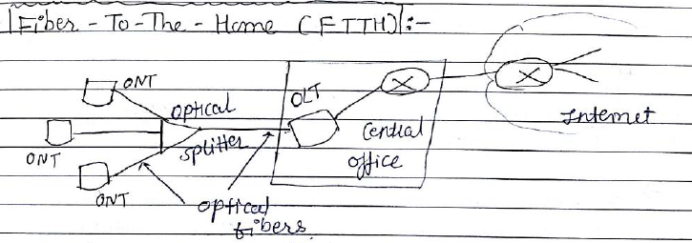
FTTH (Fiber to the home)
ONT: Optical Network Terminal
OLT: Optical Line Terminal

Slide 11
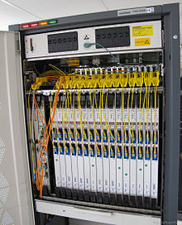
OLT
To perform conversion between the electrical signals used by the service provider's equipment and the fiber optic signals
to coordinate the multiplexing between the conversion devices on the other end of that network

Slide 12
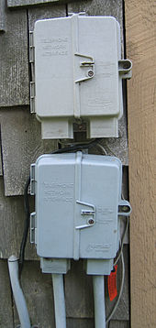
ONT
An optical network terminal (ONT) is used to terminate the fiber optic line, demultiplex the signal into its component parts (voice telephone, television, and Internet access), and provide power to customer telephones.

Slide 13
Fiber Optic offers higher transmission rate than coaxial cables and twisted pair
Main advantage is simplest distribution or individual connection to the home from central office
There are two competing optical distribution n/w Spiliting :
AON: Active Optical Network – Distribute Signals (point to point network)
PON: Passive Optical Network – Collect and separating signals
Speed:
10-20 mbps for download
2-10 mbps for upload)

